Slide 1

Discovering a Global Data Model from Event Logs
Kim-Pascal Borchart
BPI @ HPI
Summer 2021

Slide 2
Agenda
Write your first topic here
Write your second topic here
Highlight your topics by using bold font (change manually)
Write your fourth topic here
If you need further details
Choose the second text layer

Slide 3
Recap - Model Discovery on Single Event Log
Start
Attr_1
Bano, Dorina & Weske, Mathias. (2020). Discovering Data Models from Event Logs
Case | Activity | Time | Attr_1 | Attr_2 | Attr_3
1 | Start | 1 | True |  | hello
1 | Do | 2 |  | 9.001
2 | Start | 3 | False |  | hi
2 | Do | 4 |  | 8.999
1 | Finish | 4 | False |  | bye
2 | Finish | 5 | True |  | see you
3 | Start | 6 | False |  | howdy!
Do
Attr_2
Finish
Attr_3
1
Attr_1 Attr_3
2
Attr_2

Slide 4
Recap - Problem Definition
Multiple event logs => One data model
Case | Activity | Time | Attr_1 | Attr_2 | Attr_3
1 | Start | 1 | True |  | hello
1 | Do | 2 |  | 9.001
2 | Start | 3 | False |  | hi
2 | Do | 4 |  | 8.999
1 | Finish | 4 | False |  | bye
2 | Finish | 5 | True |  | see you
3 | Start | 6 | False
1
Attr_1 Attr_3
?
2
Attr_2
Case | Activity | Time | Attr_1 | Attr_2 | Attr_3
1 | Start | 1 | True |  | hello
1 | Do | 2 |  | 9.001
2 | Start | 3 | False |  | hi
2 | Do | 4 |  | 8.999
1 | Finish | 4 | False |  | bye
2 | Finish | 5 | True |  | see you
3 | Start | 6 | False
N
Attr_n-2 Attr_n-1 Attr_n

Slide 5
Recap - Approach – „Naive“
1
Attr_1 Attr_3
Case | Activity | Time | Attr_1 | Attr_2 | Attr_3
1 | Start | 1 | True |  | hello
1 | Do | 2 |  | 9.001
2 | Start | 3 | False |  | hi
2 | Do | 4 |  | 8.999
1 | Finish | 4 | False |  | bye
2 | Finish | 5 | True |  | see you
3 | Start | 6 | False
1
Attr_1 Attr_3
Start
Attr_1
2
Attr_2
Do
Attr_2
2
Attr_2
Finish
Attr_3
N
Attr_n-2 Attr_n-1 Attr_n
N-1
Attr_n-2 Attr_n-1 Attr_n
Case | Activity | Time | Attr_1 | Attr_2 | Attr_3
1 | Start | 1 | True |  | hello
1 | Do | 2 |  | 9.001
2 | Start | 3 | False |  | hi
2 | Do | 4 |  | 8.999
1 | Finish | 4 | False |  | bye
2 | Finish | 5 | True |  | see you
3 | Start | 6 | False
N
Attr_n-2 Attr_n-1 Attr_n
Start
Attr_1
Do
Attr_2
N
Attr_n-2 Attr_n-1 Attr_n
Finish
Attr_3

Slide 6
Recap – Approach – „Naive“ v2
Case | Activity | Time | Attr_1 | Attr_2 | Attr_3
1 | Start | 1 | True |  | hello
1 | Do | 2 |  | 9.001
2 | Start | 3 | False |  | hi
2 | Do | 4 |  | 8.999
1 | Finish | 4 | False |  | bye
2 | Finish | 5 | True |  | see you
3 | Start | 6 | False
Case | Activity | Time | Attr_1 | Attr_2 | Attr_3
1 | Start | 1 | True |  | hello
1 | Do | 2 |  | 9.001
2 | Start | 3 | False |  | hi
2 | Do | 4 |  | 8.999
1 | Finish | 4 | False |  | bye
2 | Finish | 5 | True |  | see you
3 | Start | 6 | False
1
Attr_1 Attr_3
Start
Attr_1
2
Attr_2
 |  |  | Case | Activity | Time | Attr_1 | Attr_2 | Attr_3
 |  |  | 1 | Start | 1 | True |  | hello
 |  |  | 1 | Do | 2 |  | 9.001
 |  |  | 2 | Start | 3 | False |  | hi
 |  |  | 2 | Do | 4 |  | 8.999
 |  |  | 1 | Finish | 4 | False |  | bye
 |  |  | 2 | Finish | 5 | True |  | see you
 |  |  | 3 | Start | 6 | False
Do
Attr_2
Case | Activity | Time | Attr_1 | Attr_2 | Attr_3
1 | Start | 1 | True |  | hello
1 | Do | 2 |  | 9.001
2 | Start | 3 | False |  | hi
2 | Do | 4 |  | 8.999
1 | Finish | 4 | False |  | bye
2 | Finish | 5 | True |  | see you
3 | Start | 6 | False
Finish
Attr_3
N
Attr_n-2 Attr_n-1 Attr_n

Slide 7
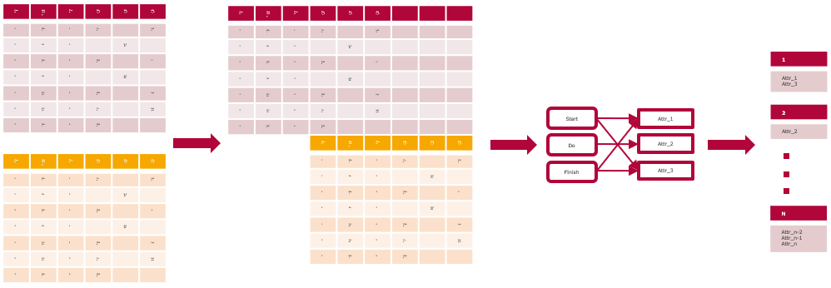
Approach – „Naive“

Slide 8
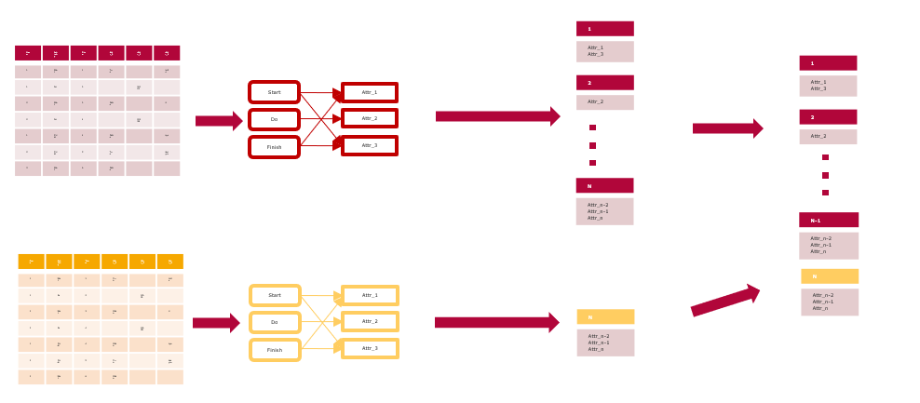
Approach – „Naive“ v2

Slide 9
A2A Diagrams - Example
Access
Att1
A
Att2
B
Activities
Attributes
Att3
C
Att4

Slide 10
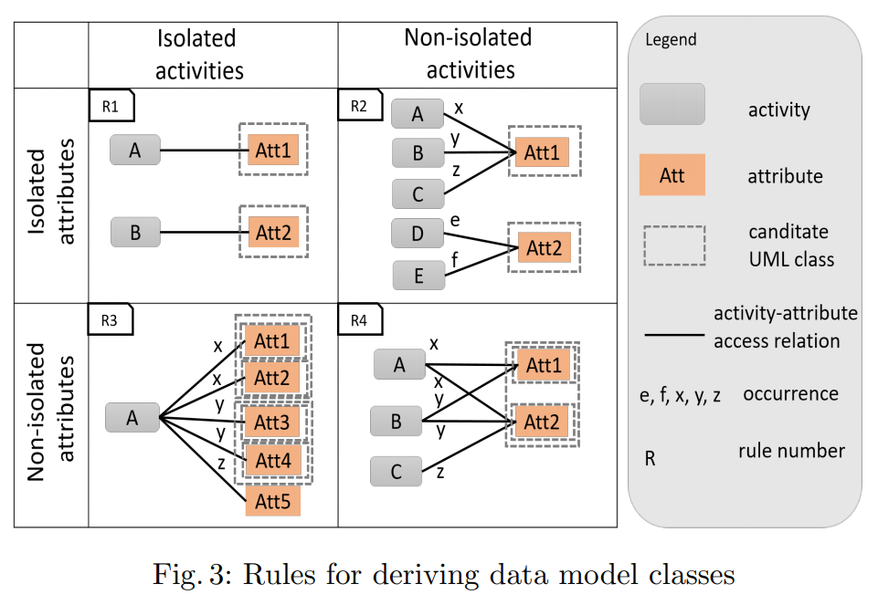
A2A Diagrams - Example
Att1
A
Att2
B
Att3
C
Att4

Slide 11
A2A Diagrams - Example
Att1
A
Att2
B
Att3
Attr4

Slide 12
A2A Diagrams – Data Structure
A
x
Att1
x
y
Att2
B
x
y
Att3
C
x
Att4
 | Att1 | Att2 | Att3 | Att4
A | x | x | 0 | 0
B | y | x | y | 0
C | 0 | 0 | 0 | x

Slide 13
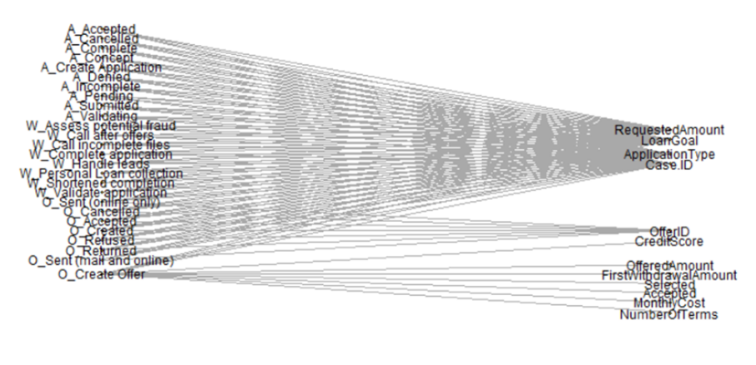
A2A Diagrams – Real World Example
A2A diagram for one BPI challenge 2017 event log

Slide 14
Intermission: Dataset – BPI Challenge 2017
Two event logs
OfferApplications: 1160405 events, 13 attributes
Offers: 193849 events, 11 attributes

Slide 15
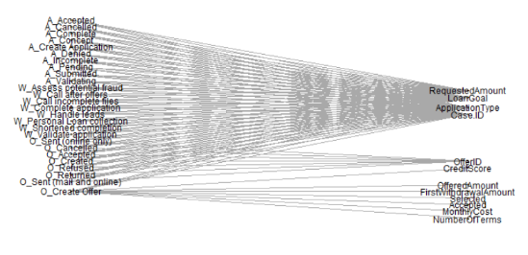
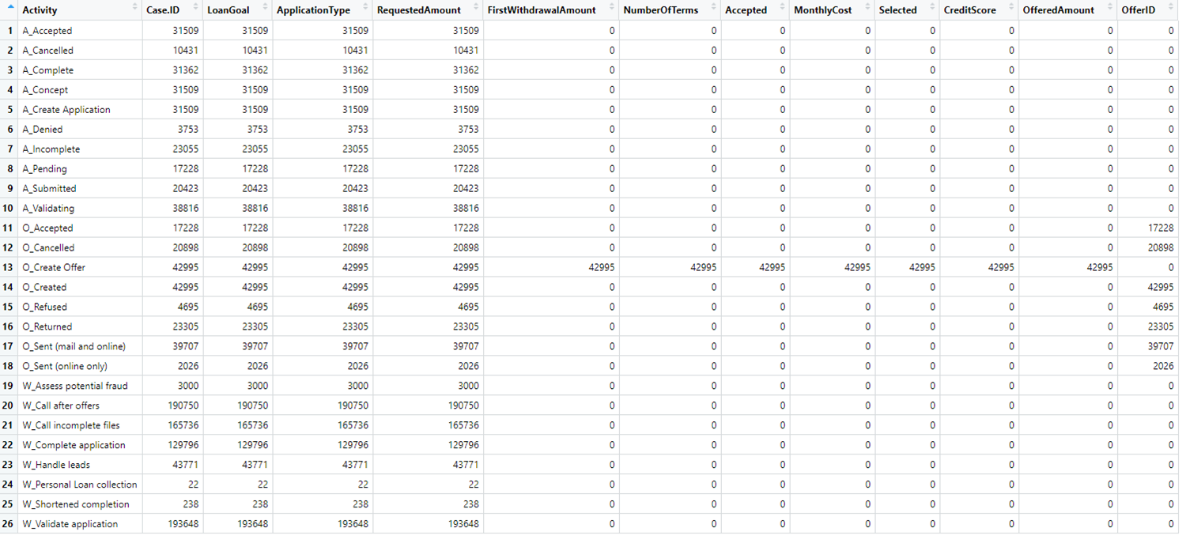
A2A Diagrams – Data Structure

Slide 16
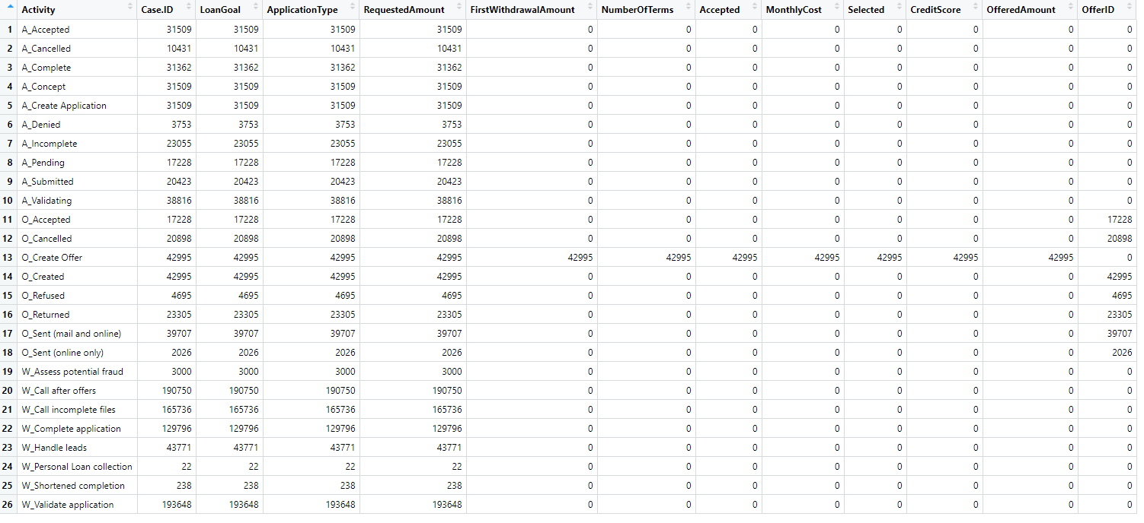
Underlying Model – Which Attributes Belong Together?

Slide 17
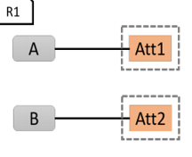
Underlying Model – Which Attributes Belong Together?
Activity | Att1 | Att2 | Att3 | Att4 | Att5 | Att6 | Att7
A |  |  |  |  | 0
B | 0 | 0 | 0 | 0 | x | 0 | 0
C |  |  |  |  | 0
D |  |  |  |  | 0
E |  |  |  |  | 0
Rule 1

Slide 18
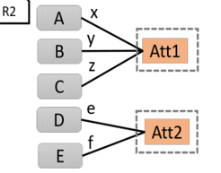
Underlying Model – Which Attributes Belong Together?
Activity | Att1 | Att2 | Att3 | Att4 | Att5 | Att6 | Att7
A |  |  |  |  | 0
B | 0 | 0 | 0 | 0 | x | 0 | 0
C |  |  |  |  | 0
D |  |  |  |  | 0
E |  |  |  |  | 0
Activity | Att1 | Att2 | Att3 | Att4 | Att5 | Att6 | Att7
A |  |  |  |  | 0
B | 0 | 0 | 0 | 0 | x | 0 | 0
C | 0 | 0 | 0 | 0 | x | 0 | 0
D | 0 | 0 | 0 | 0 | x | 0 | 0
E |  |  |  |  | 0
Rule 2

Slide 19
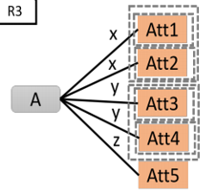
Underlying Model – Which Attributes Belong Together?
Activity | Att1 | Att2 | Att3 | Att4 | Att5 | Att6 | Att7
A |  |  |  |  | 0
B | 0 | 0 | 0 | 0 | x | 0 | 0
C |  |  |  |  | 0
D |  |  |  |  | 0
E |  |  |  |  | 0
Activity | Att1 | Att2 | Att3 | Att4 | Att5 | Att6 | Att7
A |  |  | 0 | 0 | 0
B | 0 | 0 | x | x | x | 0 | 0
C |  |  | 0 | 0 | 0
D |  |  | 0 | 0 | 0
E |  |  | 0 | 0 | 0
Rule 3

Slide 20
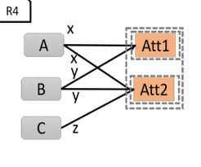
Underlying Model – Which Attributes Belong Together?
Activity | Att1 | Att2 | Att3 | Att4 | Att5 | Att6 | Att7
A |  |  |  |  | 0
B | 0 | 0 | 0 | 0 | x | 0 | 0
C |  |  |  |  | 0
D |  |  |  |  | 0
E |  |  |  |  | 0
Activity | Att1 | Att2 | Att3 | Att4 | Att5 | Att6 | Att7
A | z | 0 | 0 | m | n | z | 0
B | y | y | x | x | x | 0 | z
C | 0 | x | 0 | z | 0 | y | x
D | x | 0 | 0 | 0 | y | z | 0
E | 0 | y | 0 | x | 0 | 0 | x
Rule 4

Slide 21
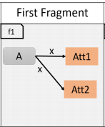
Underlying Model – Which Attributes Belong Together?
Activity | Att1 | Att2 | Att3 | Att4 | Att5 | Att6 | Att7
A |  |  |  |  | 0
B | 0 | 0 | 0 | 0 | x | 0 | 0
C |  |  |  |  | 0
D |  |  |  |  | 0
E |  |  |  |  | 0
Activity | Att1 | Att2 | Att3 | Att4 | Att5 | Att6 | Att7
A | z | 0 | 0 | m | n | z | 0
B | y | y | x | x | x | 0 | z
C | 0 | x | 0 | z | 0 | y | x
D | x | 0 | 0 | 0 | y | z | 0
E | 0 | y | 0 | x | 0 | 0 | x
Activity | Att1 | Att2 | Att3 | Att4 | Att5 | Att6 | Att7
A | z | 0 | 0 | m | n | z | 0
B | y | y | x | x | x | 0 | z
C | 0 | x | 0 | z | 0 | y | x
D | x | 0 | 0 | 0 | y | z | 0
E | 0 | y | 0 | x | 0 | 0
Rule 4

Slide 22
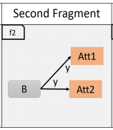
Underlying Model – Which Attributes Belong Together?
Activity | Att1 | Att2 | Att3 | Att4 | Att5 | Att6 | Att7
A |  |  |  |  | 0
B | 0 | 0 | 0 | 0 | x | 0 | 0
C |  |  |  |  | 0
D |  |  |  |  | 0
E |  |  |  |  | 0
Activity | Att1 | Att2 | Att3 | Att4 | Att5 | Att6 | Att7
A | z | 0 | 0 | m | n | z | 0
B | y | y | x | x | x | 0 | z
C | 0 | x | 0 | z | 0 | y | x
D | x | 0 | 0 | 0 | y | z | 0
E | 0 | y | 0 | x | 0 | 0 | x
Activity | Att1 | Att2 | Att3 | Att4 | Att5 | Att6 | Att7
A | z | 0 | 0 | m | n | z | 0
B | y | y | x | x | x | 0 | z
C | 0 | x | 0 | z | 0 | y | x
D | x | 0 | 0 | 0 | y | z | 0
E | 0 | y | 0 | x | 0 | 0 | x
Rule 4

Slide 23
Careful. Context switch!

Slide 24
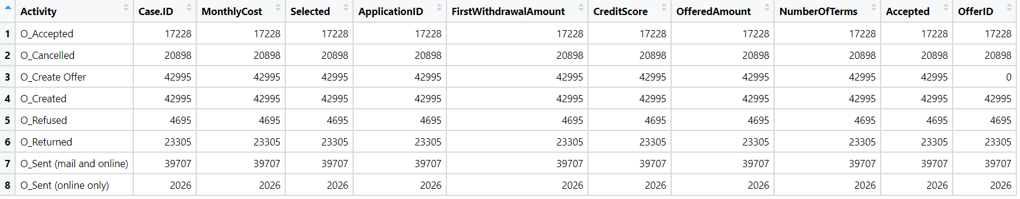
Offers – A2A Matrix

Slide 25
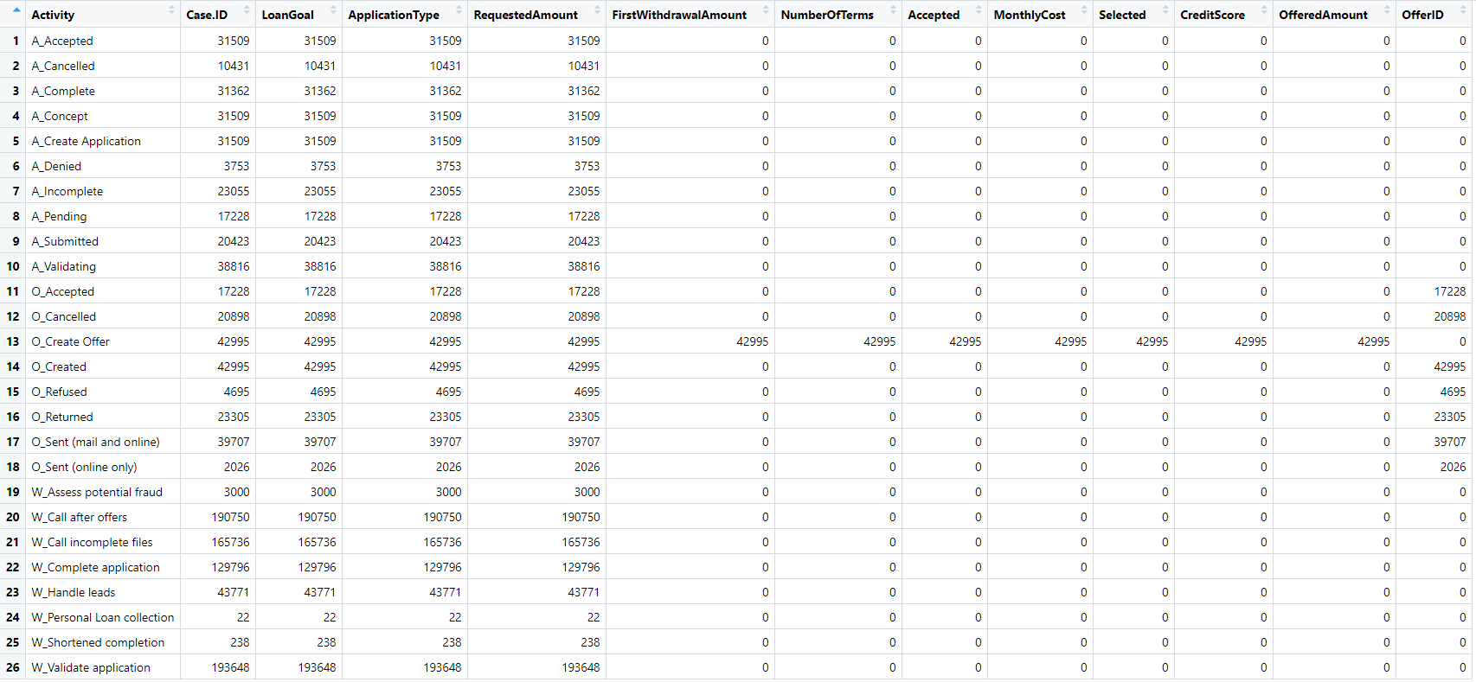
OfferApplications – A2A Matrix

Slide 26
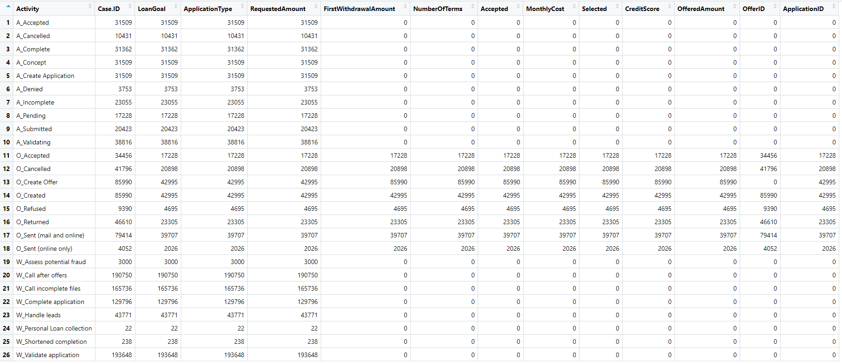
Union(OfferApplications, Offers) – A2A Matrix

Slide 27
New Rule: Multilog Access
„Each set of cells accessed by multiple event logs is treated as accessed by the same data model class.“

Slide 28
New Rule: Multilog Access
„Each set of cells accessed by multiple event logs is treated as accessed by the same data model class.“
t1
Case.ID
FirstWithdrawalAmount
NumberOfTerms
Accepted
MonthlyCost
Selected
CreditScore
OfferedAmount
OfferID

Slide 29
Definition: Fully Connected A2A
„A2A diagram/matrix in which all activities access all attributes“
Att1
 | Att1 | Att2 | Att3
A | x | y | z
B | x | y | x
C | x | x | y
A
Att2
B
Att3
C
Att4

Slide 30
Definition: Partially Fully Connected A2A
„A2A diagrams / matrices in which a subset of activities always accesses a subset of attributes“
Att1
 | Att1 | Att2 | Att3 | Att4
A | x | y | z | 0
B | x | x | x | 0
C | x | x | x | 0
D | 0 | 0 | 0 | y
A
Att2
B
Att3
C
Att4
D
Att5

Slide 31
New Rule: (Partially) Fully Connected A2A
Attributes belonging to partially fully connected a2a subsets are treated as belonging to one data class
c1
Case.ID
FirstWithdrawalAmount
NumberOfTerms
Accepted
MonthlyCost
Selected
CreditScore
OfferedAmount
OfferID
c2
LoanGoal
ApplicationType
RequestedAmount
ApplicationId

Slide 32
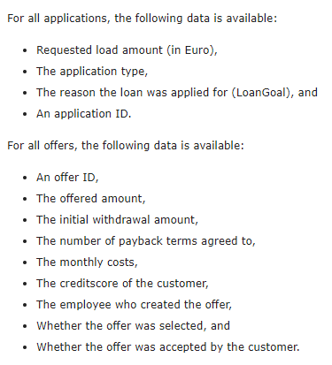
BPI 2017 Challenge Data Definition vs. Result
https://www.win.tue.nl/bpi/doku.php?id=2017:challenge
c2
LoanGoal
ApplicationType
RequestedAmount
ApplicationId
c1
Case.ID
FirstWithdrawalAmount
NumberOfTerms
Accepted
MonthlyCost
Selected
CreditScore
OfferedAmount
OfferID

Slide 33
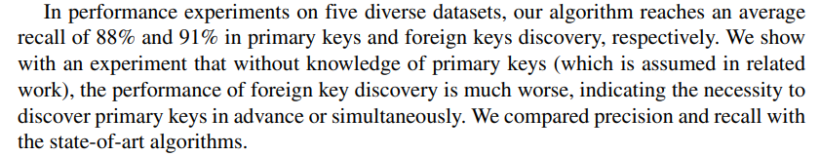
Limitation - Key Matching
c1
Case.ID
FirstWithdrawalAmount
NumberOfTerms
Accepted
MonthlyCost
Selected
CreditScore
OfferedAmount
OfferID
c2
LoanGoal
ApplicationType
RequestedAmount
ApplicationId
Jiang, L., Naumann, F. Holistic primary key and foreign key detection. J Intell Inf Syst 54, 439–461 (2020)

Slide 34
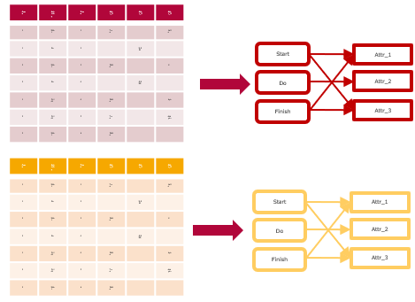
Proposed Algorithm
A2A for all EL
Multilog-Rule + Combine (Union)
Fully Connected Rule
Rules 1-4 as normal

Slide 35
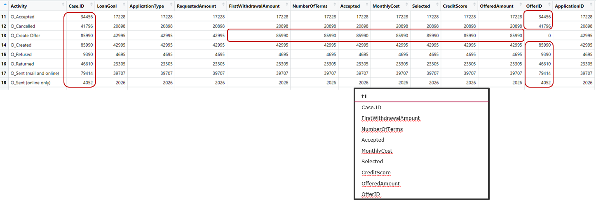
Proposed Algorithm
A2A for all EL
Multilog-Rule + Combine (Union)
Fully Connected Rule
Rules 1-4 as normal

Slide 36
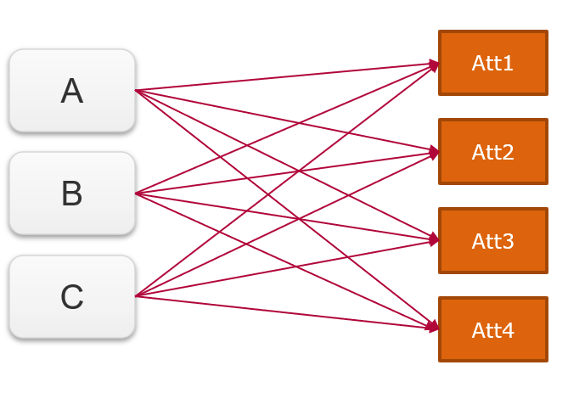
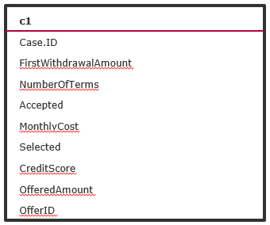
Proposed Algorithm
A2A for all EL
Multilog-Rule + Combine (Union)
Fully Connected Rule
Rules 1-4 as normal

Slide 37
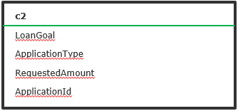
Proposed Algorithm
A2A for all EL
Multilog-Rule + Combine (Union)
Fully Connected Rule
Rules 1-4 as normal

Slide 38

Proposed Algorithm
A2A for all EL
Multilog-Rule + Combine (Union)
Fully Connected Rule
Rules 1-4 as normal

Slide 39
Dataset Overview – BPI Challenge 2020
Dataset of five event logs
Permits: 86581 events, 170 attributes
DomesticDeclarations: 56437 events, 7 attributes
InternationalDeclarations: 72151 events, 20 attributes
PrepaidTravelCost: 18246 events, 19 attributes
RequestForPayment: 36796 events, 11 attributes

Slide 40
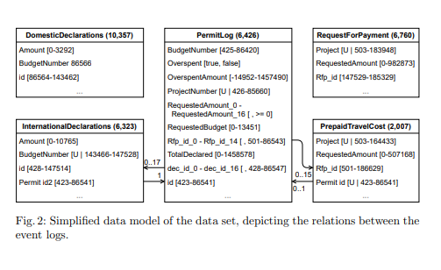
Dataset Overview – BPI Challenge 2020
Dorina Bano , Maximilian Volker , Simon Remy , Henrik Leopold , and Mathias Weske. (2020).
Multi-perspective Analysis of Approval Processes based on Multiple Event Logs

Slide 41
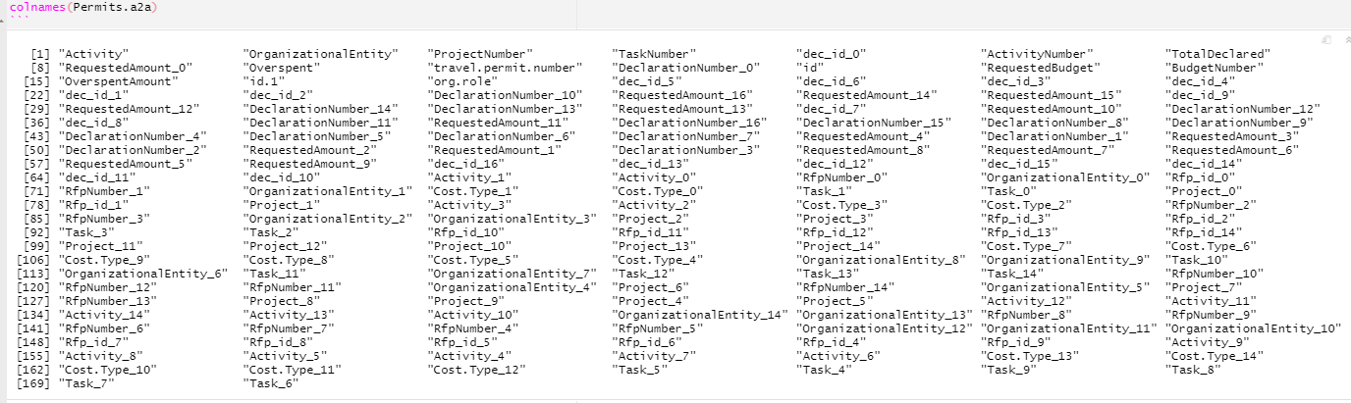
Dataset Overview – BPI Challenge 2020
0 – Not accepted. Major revisions needed.

Slide 42
BPI Challenge 2020 – Simplified
„Preprocess“ using attributes from Bano et. al Model
How close can we get to the Model?

Slide 43
Simplified Approach
Multilog Access Rule
Fully Connected Rule
No Attributes left to assign
C1
Amount
BudgetNumber
id
C2
Project
RequestedAmount
Rfp_id
(from InternationalDeclarations + DomesticDeclarations)
(from RequestForPayment + PrepaidTravelCost)
C3
Overspent
OverspentAmount
ProjectNumber
RequestedBudget
TotalDeclared
(from full union)

Slide 44
Simplified Approach – Result vs. Bano et. al
C3
Overspent
OverspentAmount
ProjectNumber
RequestedBudget
TotalDeclared
C1
Amount
BudgetNumber
id
C2
Project
RequestedAmount
Rfp_id

Slide 45
Second Approach - Result vs. Bano et. al
C3
Overspent
OverspentAmount
ProjectNumber
RequestedBudget
TotalDeclared
C1
Amount
BudgetNumber
id
C2
Project
RequestedAmount
Rfp_id

Slide 46
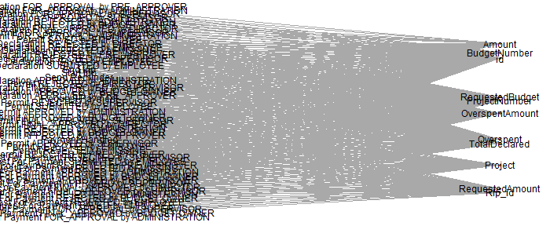
Backwards Approach - Result vs. Graphing Library
C3
Overspent
OverspentAmount
ProjectNumber
RequestedBudget
TotalDeclared
C1
Amount
BudgetNumber
id
C2
Project
RequestedAmount
Rfp_id

Slide 47
Backwards Approach - Result vs. Graphing Library
C3
Overspent
OverspentAmount
ProjectNumber
RequestedBudget
TotalDeclared
C1
Amount
BudgetNumber
id
C2
Project
RequestedAmount
Rfp_id

Slide 48
Discussion and Future Work
Assumption: Consistent naming of attributes
Interesting results for BPI Challenge datasets 2017 and 2020
BUT new rules might be overfitted
Often one sparse „main“ log
Secondary event logs fully connected
Just take any fully connected event log as one DM class?
Are there different classes of fully connectedness?
Is there auxilliary informaton to identify keys?

Slide 49

Questions | Discussion | Comments
Kim-Pascal Borchart
BPI @ HPI
Summer 2021

Slide 50
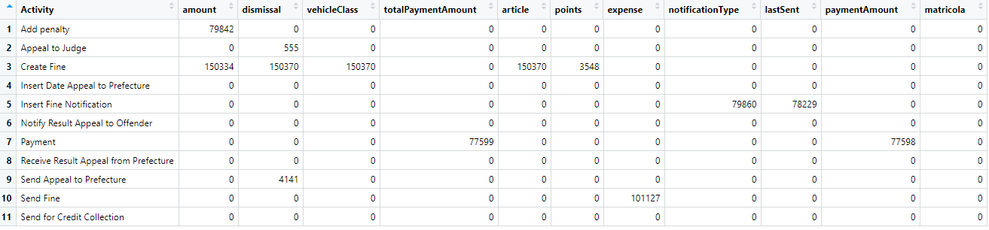
Road Traffic A2A

Slide 51
Rules in Data - Rule 1
Activity | Att1 | Att2 | Att3 | Att4 | Att5 | Att6 | Att7
A |  |  |  |  | 0
B | 0 | 0 | 0 | 0 | x | 0 | 0
C |  |  |  |  | 0
D |  |  |  |  | 0
E |  |  |  |  | 0

Slide 52
Rules in Data - Rule 2
Activity | Att1 | Att2 | Att3 | Att4 | Att5 | Att6 | Att7
A |  |  |  |  | 0
B | 0 | 0 | 0 | 0 | x | 0 | 0
C | 0 | 0 | 0 | 0 | x | 0 | 0
D | 0 | 0 | 0 | 0 | x | 0 | 0
E |  |  |  |  | 0

Slide 53
Rules in Data - Rule 3
Activity | Att1 | Att2 | Att3 | Att4 | Att5 | Att6 | Att7
A |  |  | 0 | 0 | 0
B | 0 | 0 | x | x | x | 0 | 0
C |  |  | 0 | 0 | 0
D |  |  | 0 | 0 | 0
E |  |  | 0 | 0 | 0

Slide 54
Rules in Data - Rule 4
Activity | Att1 | Att2 | Att3 | Att4 | Att5 | Att6 | Att7
A | z | 0 | 0 | m | n | z | 0
B | y | y | x | x | x | 0 | z
C | 0 | x | 0 | z | 0 | y | x
D | x | 0 | 0 | 0 | y | z | 0
E | 0 | y | 0 | x | 0 | 0 | x

Slide 55
Rule 4
Activity | Att1 | Att2 | Att3 | Att4 | Att5 | Att6 | Att7
A | z | 0 | 0 | m | n | z | 0
B | y | y | x | x | x | 0 | z
C | 0 | x | 0 | z | 0 | y | x
D | x | 0 | 0 | 0 | y | z | 0
E | 0 | y | 0 | x | 0 | 0 | x

Slide 56
Rule 4
Activity | Att1 | Att2 | Att3 | Att4 | Att5 | Att6 | Att7
A | z | 0 | 0 | m | n | z | 0
B | y | y | x | x | x | 0 | z
C | 0 | x | 0 | z | 0 | y | x
D | x | 0 | 0 | 0 | y | z | 0
E | 0 | y | 0 | x | 0 | 0 | x

Slide 58
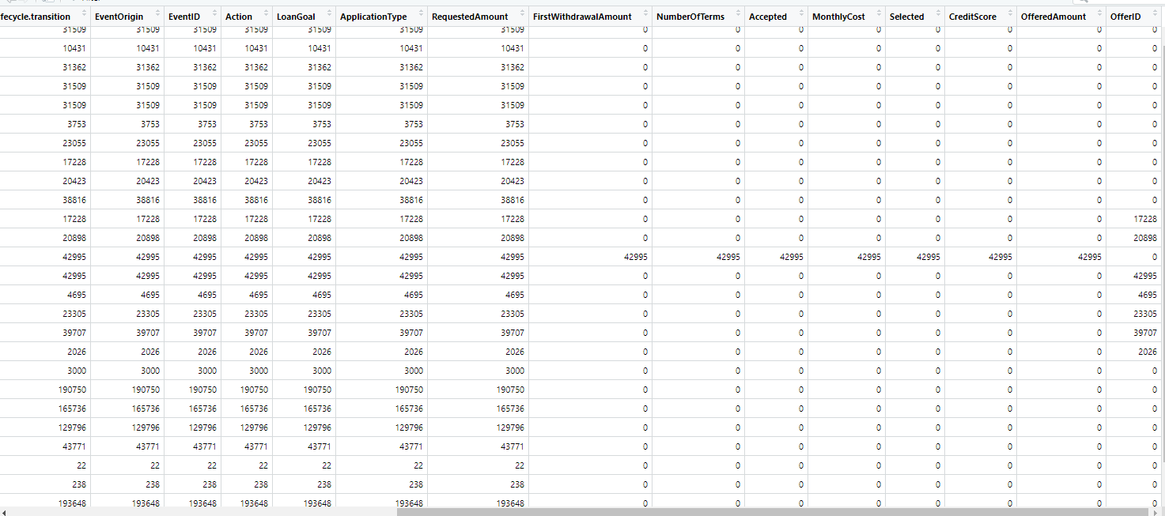

Slide 59
t1
FirstWithdrawalAmount
NumberOfTerms
Accepted
MonthlyCost
Selected
CreditScore
OfferedAmount

Slide 60
t1
FirstWithdrawalAmount
NumberOfTerms
Accepted
MonthlyCost
Selected
CreditScore
OfferedAmount

Slide 61
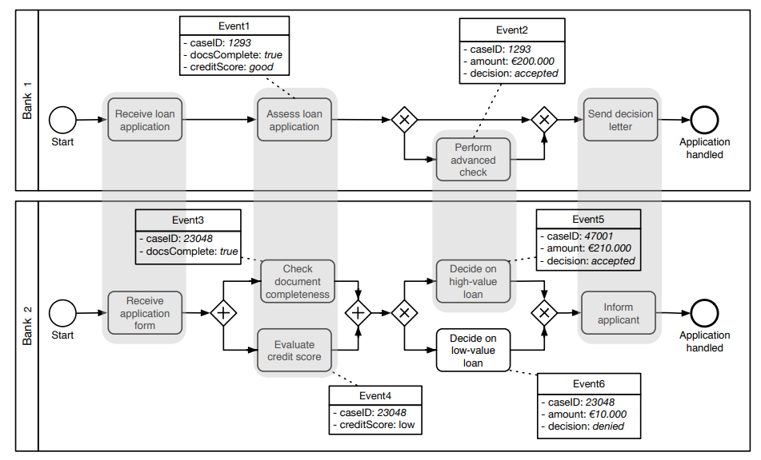
Related Work – Schema Matching on Event Logs
van der Aa, Han & Gal, Avigdor & Leopold, Henrik & Reijers, Hajo & Sagi, Tomer & Shraga, Roee. (2017). Instance-Based Process Matching Using Event-Log Information.
Instance-based approach
Attribute Name Similarity
Attribute Value Similarity
Occurrence Similarity (frequency)
Additional process-related metrics:
Positional Similarity
Duration Similarity
Prerequisites Similarity

Slide 62
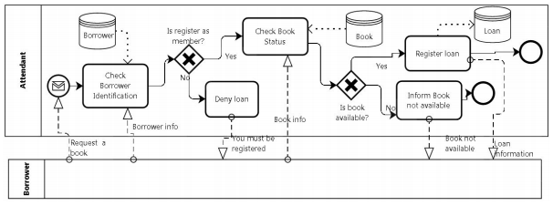
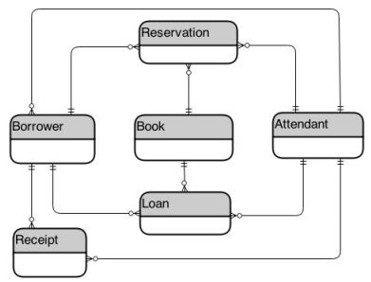
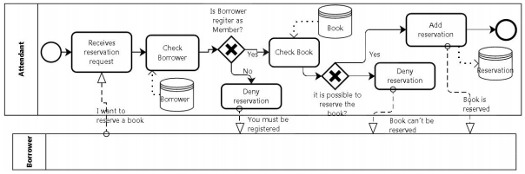
Related Work – Deriving Data Model from Related BPMs
Cruz, Estrela & Machado, Ricardo-J & Santos, Maribel. (2015). Deriving a Data Model from a Set of Interrelated Business Process Models.

Slide 63


Slide 64


Slide 65
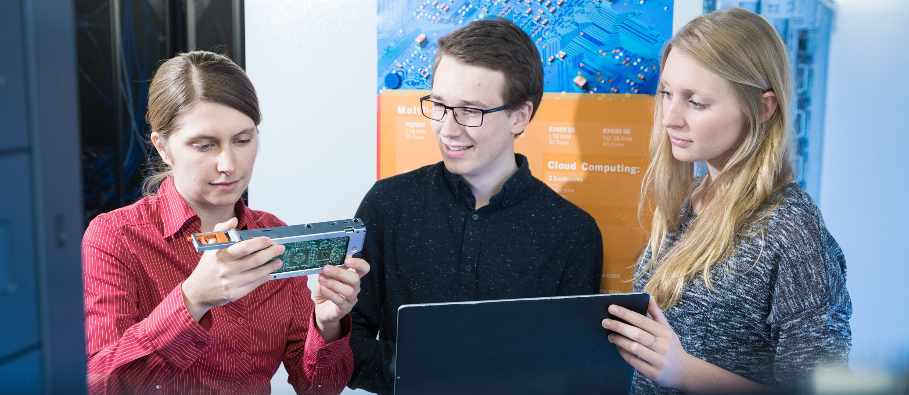

Slide 66

Explanations - Text layers
First text layer for running text.
Second level for bullet points
Third level for bullet points
Fourth level for bullet points
Fifth level for numberings
Sixth level for listings
Seventh text layer for Core Messages
In this template, we pre-formatted different text layers (as you can see on the right side). You don’t have to generate bullet points manually. By the way: Please avoid this!
To change from one text layer to the next, use the Increase / Decrease List Level buttons:

Slide 67
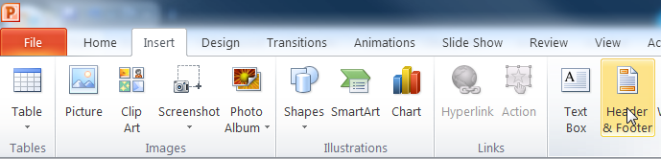
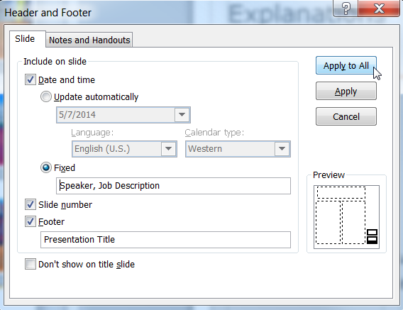
Explanations - Footer
You can insert or change your presentation‘s footer. Click on the Insert-tab | Header and Footer | After filling in your descriptions click on Apply to All.
Descriptions:
Activate date and time and write in:Speaker, Job Description
Activate the slide number.
Activate the footer and write in: Presentation Title
Don‘t use the template without the complete footer.

Slide 68
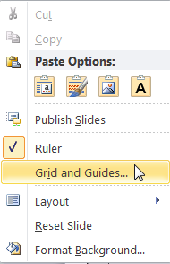
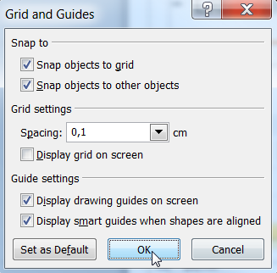
Explanations - Drawing guides
You can enable your guide-lines to align objects on the slide (View | Show | Select the option „Guides“)
Or hit the right mouse button outside the slide and go at „Grid and Guides…“

Slide 69
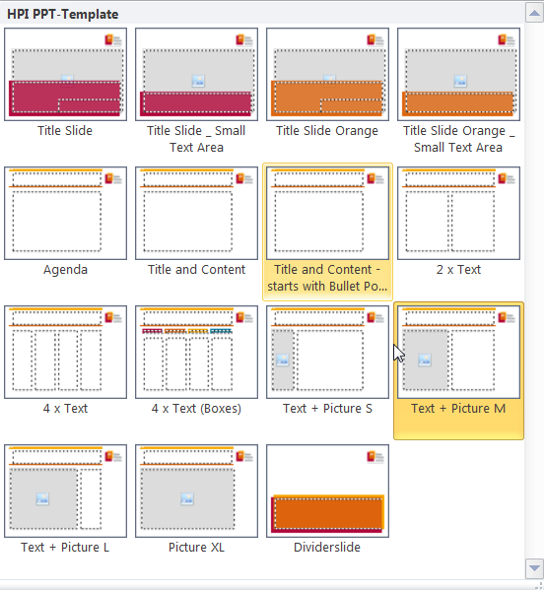
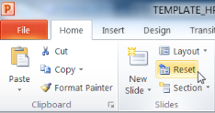
Explanations - Slide layouts
You can choose between different slide layouts. These pre-defined layouts gives you the oportunity to use text and visualisations just the right way.
To use these layouts:
Click on the Home-tab | New Slide or Layout | and choose one out of the layouts
Click „Reset“ to reset to the predefined slide layout.

